Slide 1
Chapter 2: Introduction to Relational Model
Notes:
1

Slide 2
Relational Query Languages
Procedural vs .non-procedural, or declarative
“Pure” languages:
Relational algebra
Tuple relational calculus
Domain relational calculus
The above 3 pure languages are equivalent in computing power
We will concentrate in this chapter on relational algebra
Not turning-machine equivalent
consists of 6 basic operations
Notes:
2

Slide 3
Relational Algebra
A procedural language consisting of a set of operations that take one or two relations as input and produce a new relation as their result.
Six basic operators
select: 𝞂
project: 𝜫
union: ⋃
set difference: –
Cartesian product: x
rename: ⍴

Slide 4
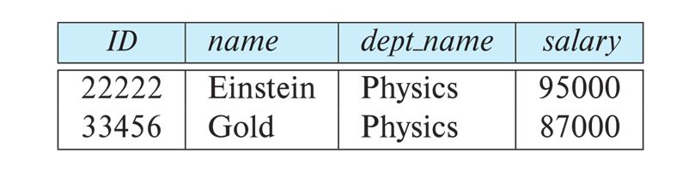
Select Operation
The select operation selects tuples that satisfy a given predicate.
Notation: 𝞂 _{p} (R)
p is called the selection predicate
Example: select those tuples of the instructor relation where the instructor is in the “Physics” department.
Query
𝞂_{dept_name=“Physics”} (instructor)
•Result

Slide 5
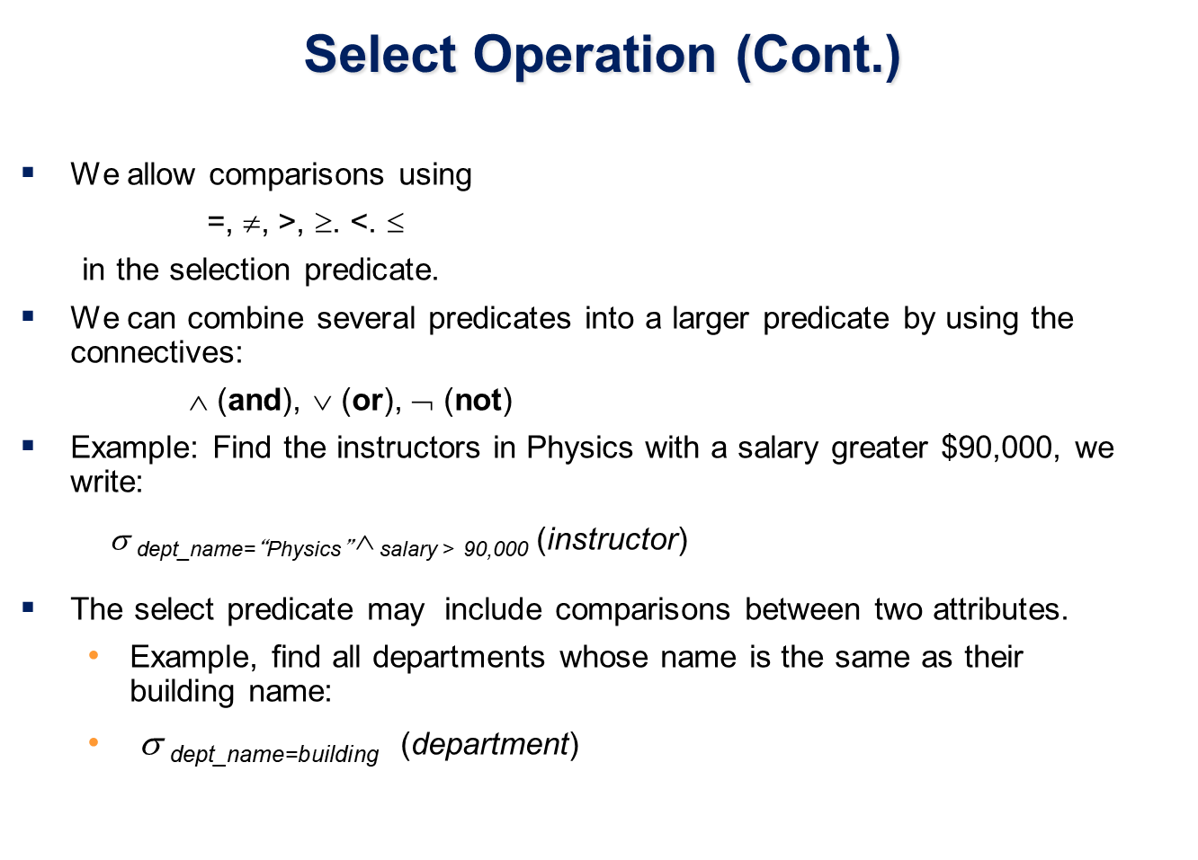

Slide 6
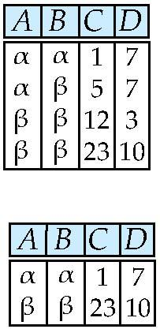
Select Operation – selection of rows (tuples)
Relation r
σ_{A=B ^ D > 5} (r)
Notes:
6

Slide 7
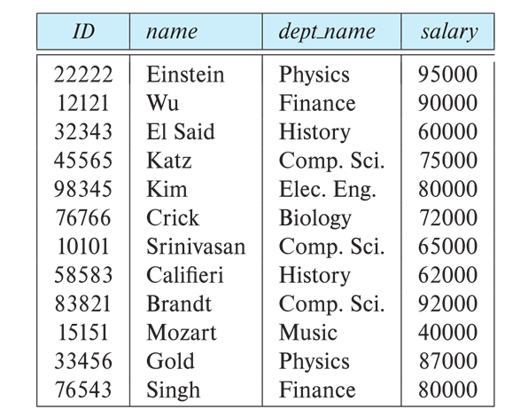
Select- Practice Example
Q: Find tuples from instructor relation where dept_name is computer science
Q: Find the tuples from instructor where salary is greater than 80000
Q: Find the tuples from instructor where dept_name is finance or salary is greater than 80000

Slide 8
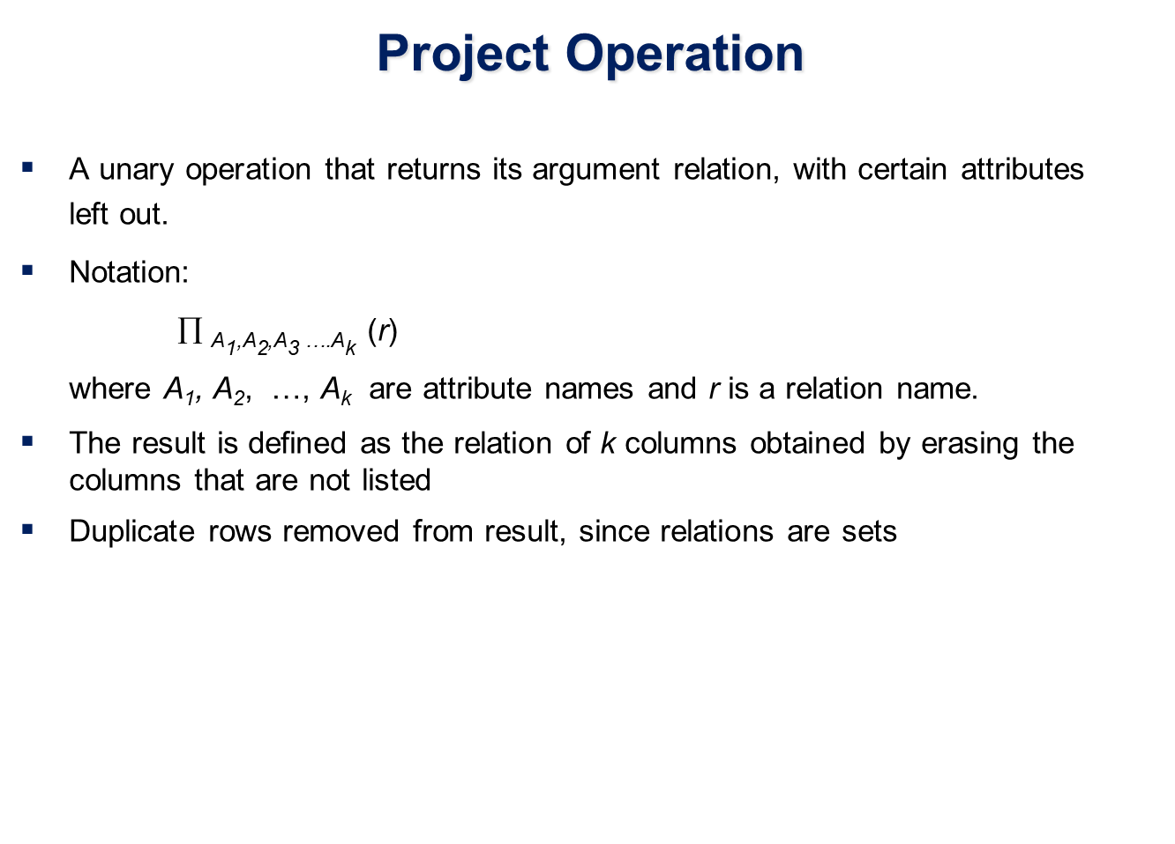

Slide 9
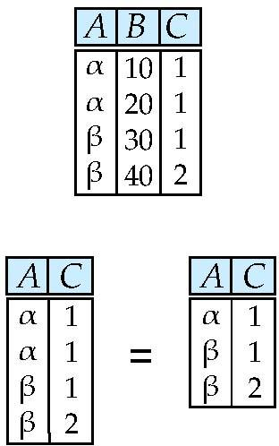
Project Operation – selection of columns (Attributes)
Relation r:
∏_{A,C} (r)
Notes:
9

Slide 10
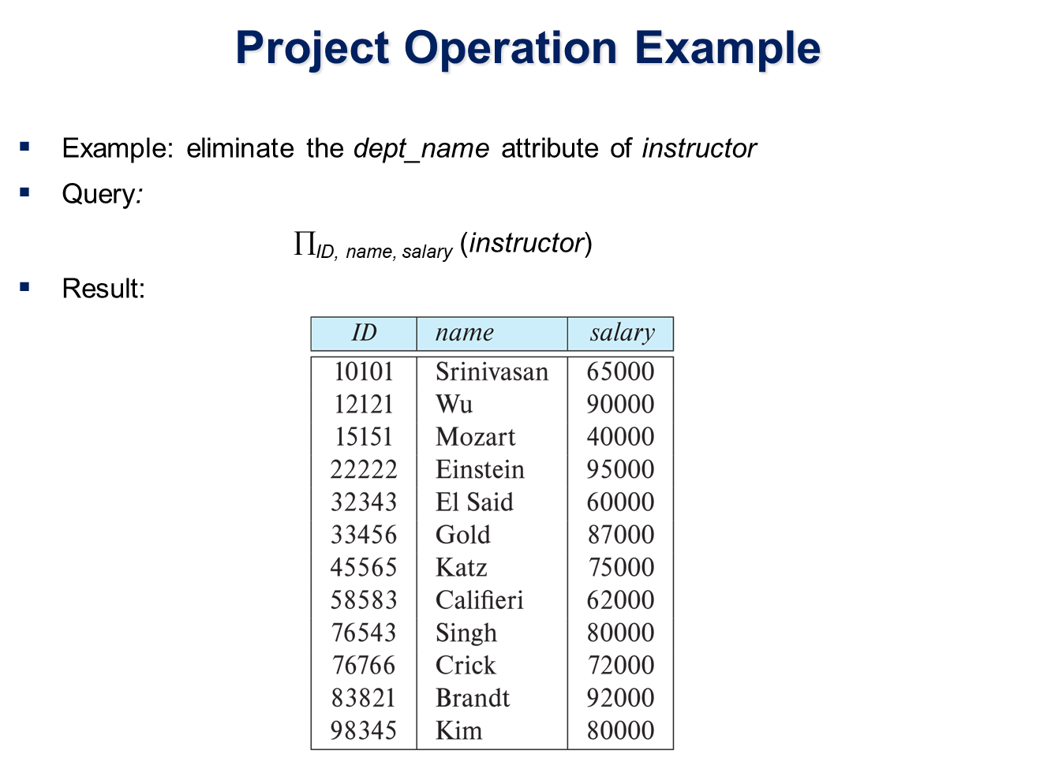

Slide 11

Project- Practice example
Q Find name of all the instructors where department is physics and salary is greater than 80000

Slide 12
Composition of Relational Operations
The result of a relational-algebra operation is relation and therefore of relational-algebra operations can be composed together into a relational-algebra expression.
Consider the query -- Find the names of all instructors in the Physics department.
𝜫_{name}(𝝈_{dept_name} _{=“Physics”} (instructor))
Instead of giving the name of a relation as the argument of the projection operation, we give an expression that evaluates to a relation.

Slide 13
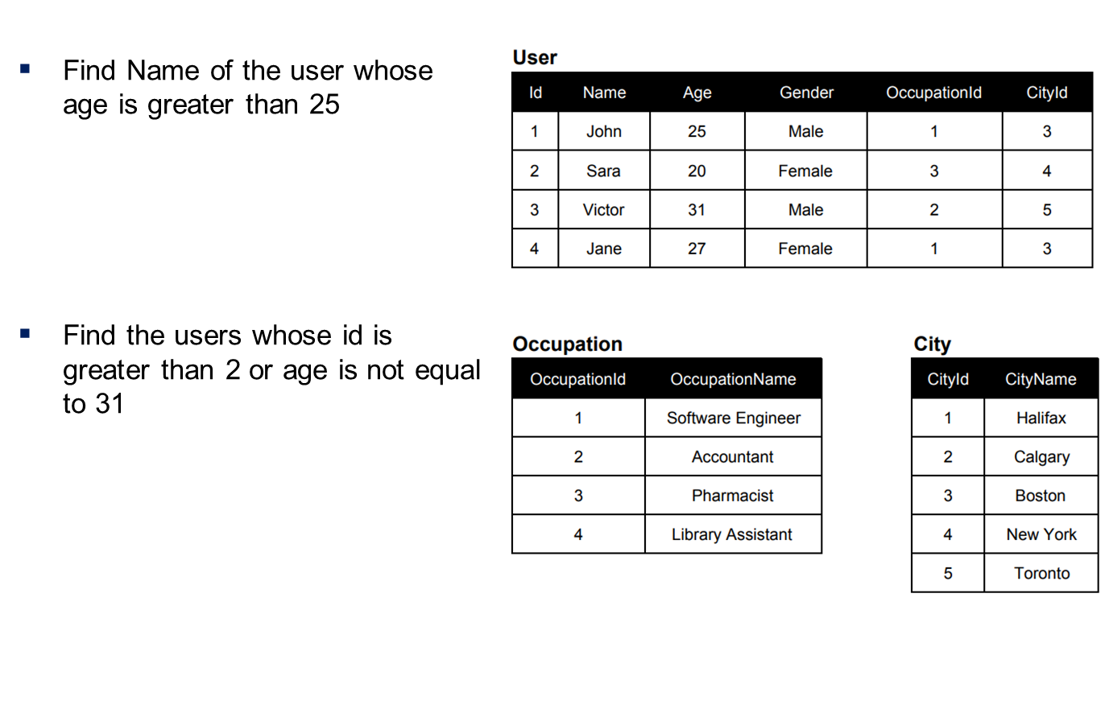
Practice Problems

Slide 14
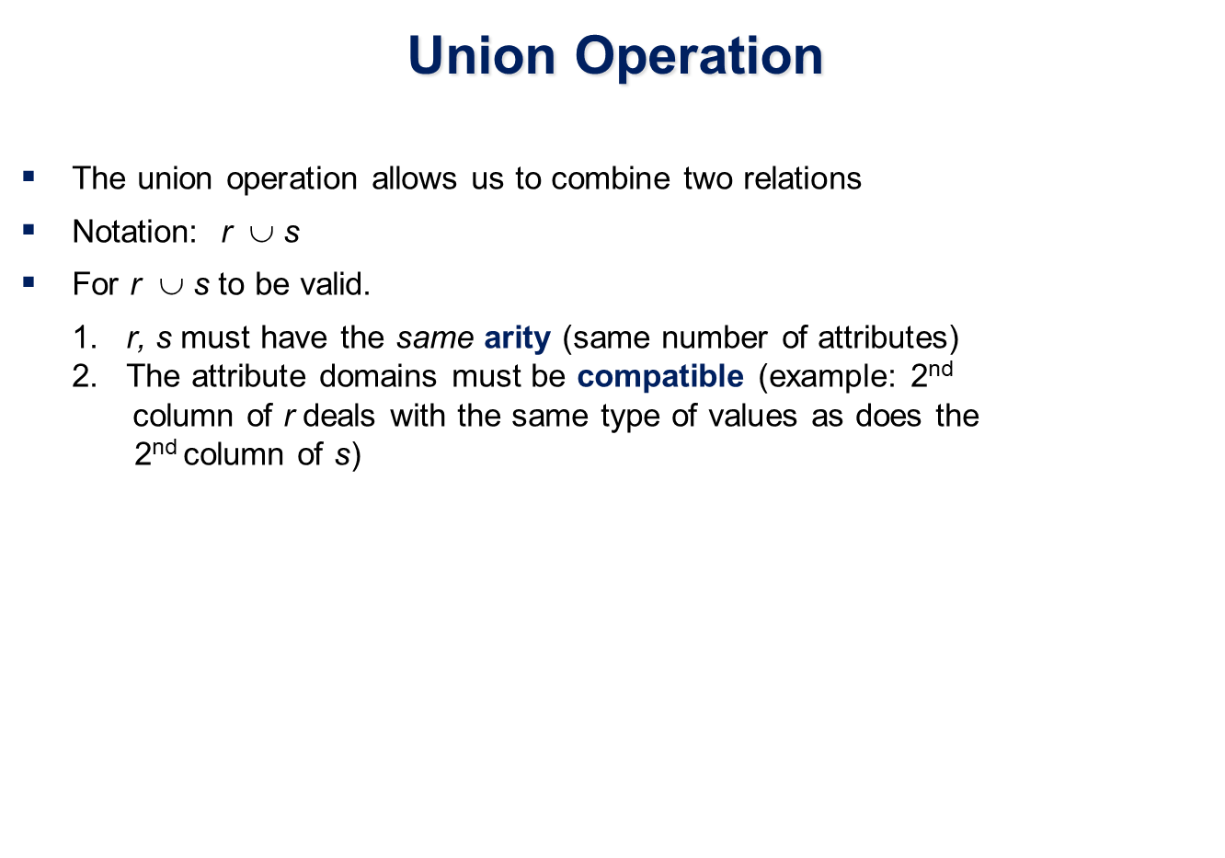

Slide 15
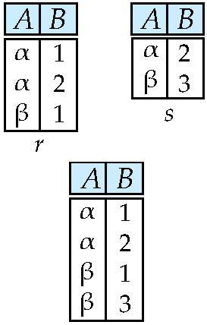
Union of two relations
Relations r, s:
r ∪ s:
Notes:
15

Slide 16
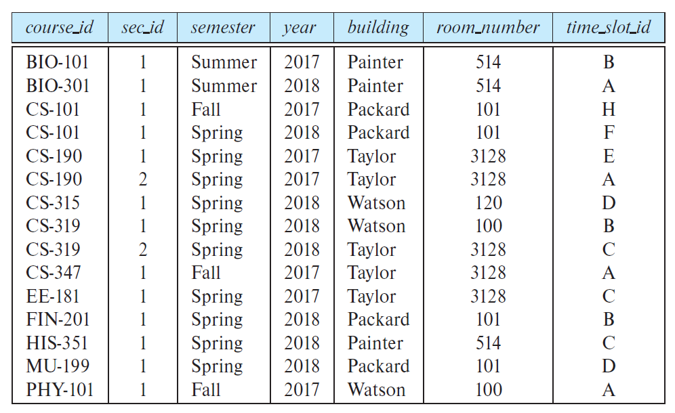
Section Relation

Slide 17
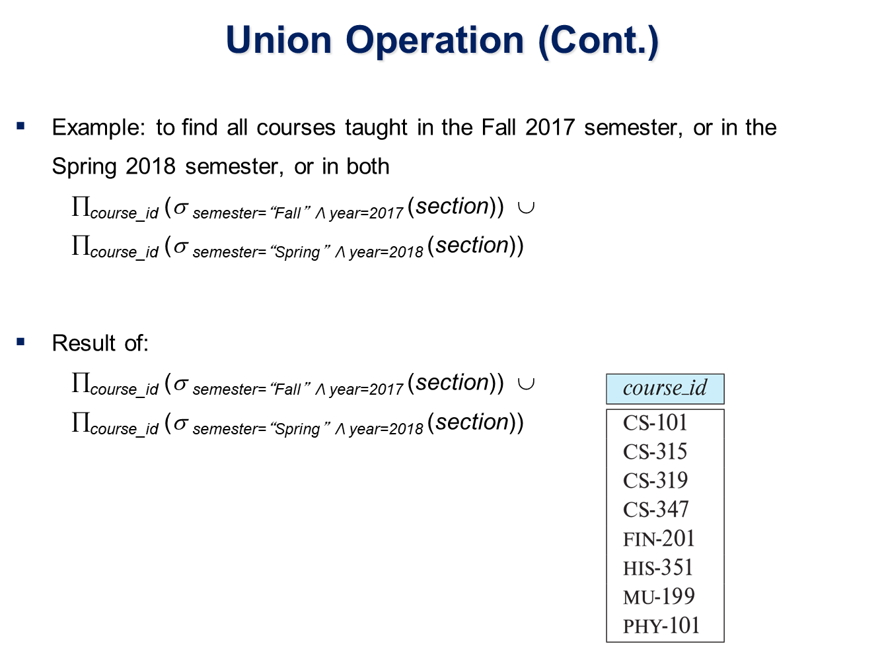

Slide 18
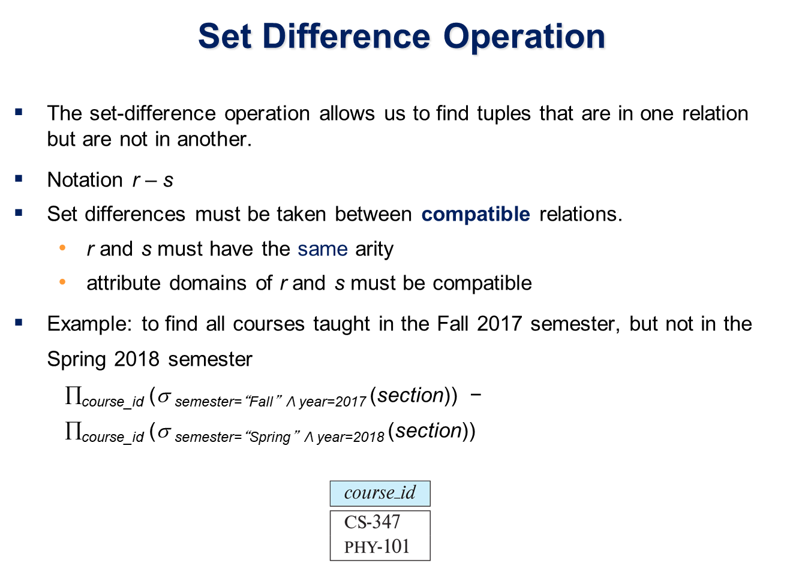

Slide 19
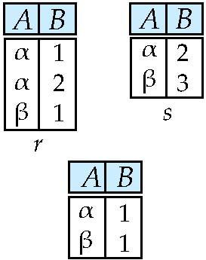
Set difference of two relations
Relations r, s:
r – s:
Notes:
19

Slide 20
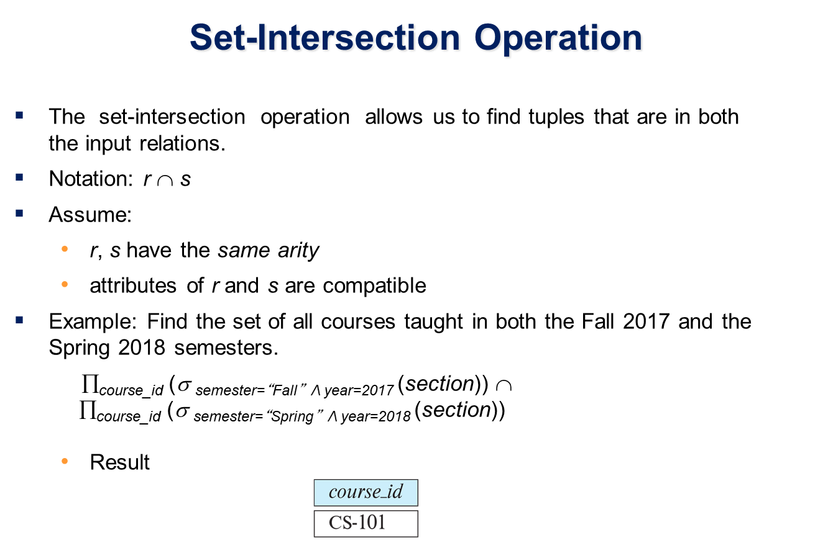

Slide 21
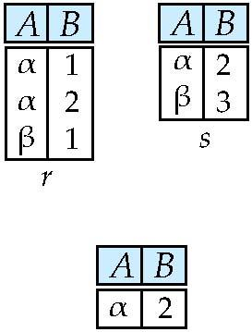
Set intersection of two relations
Relation r, s:
r ∩ s
Note: r ∩ s = r – (r – s)
Notes:
21

Slide 22
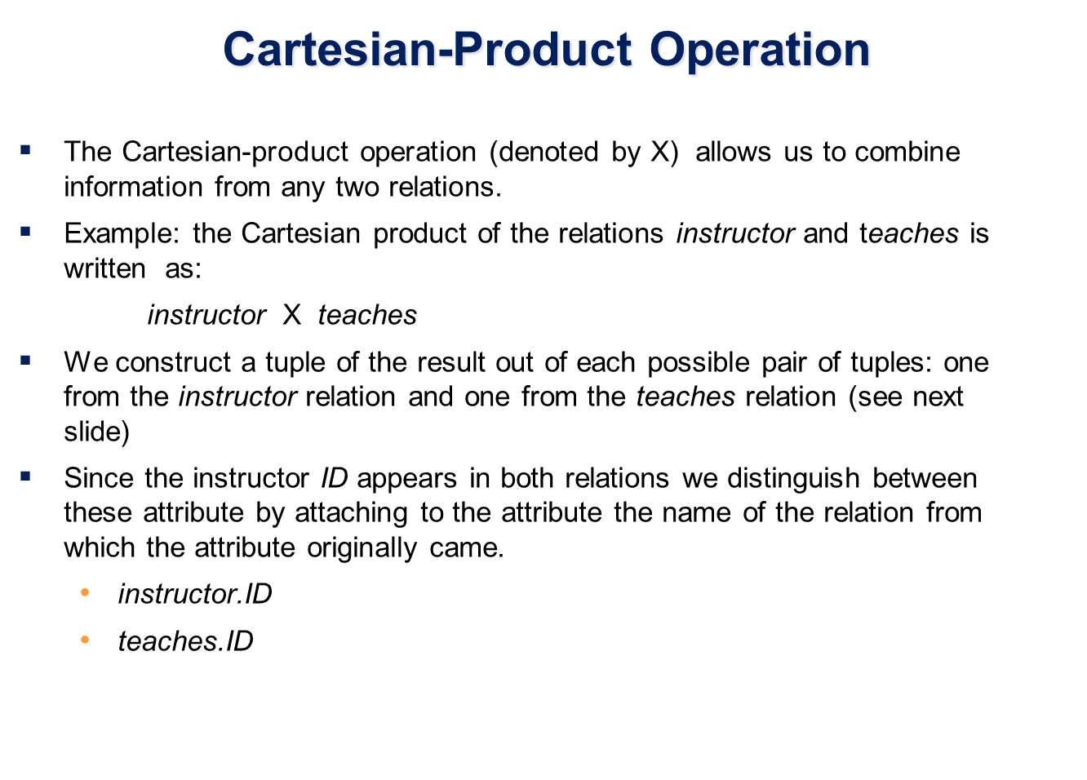

Slide 23
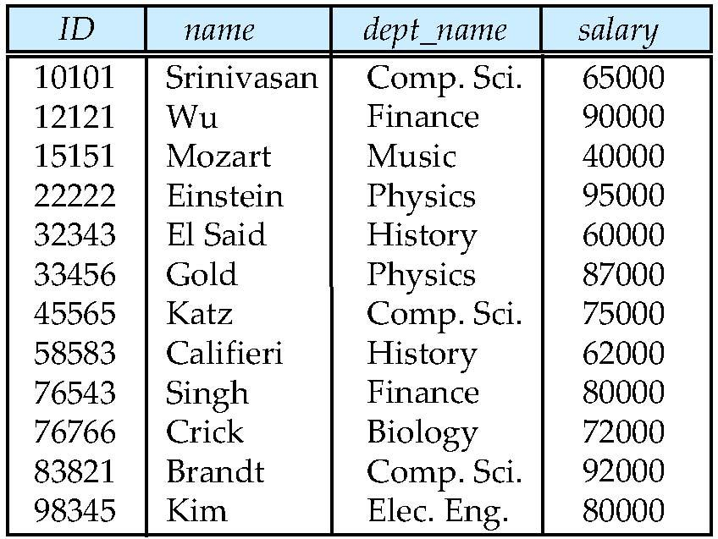
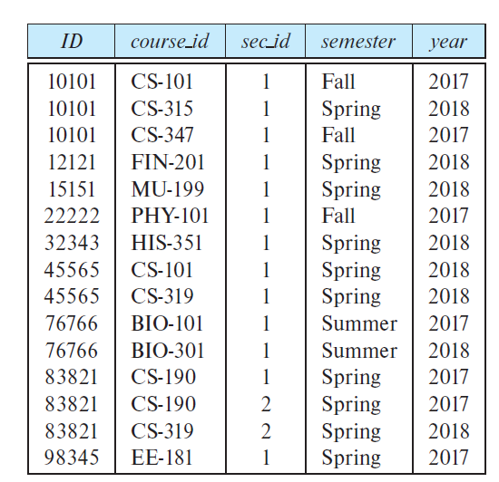
Instructor relation teaches relation

Slide 24
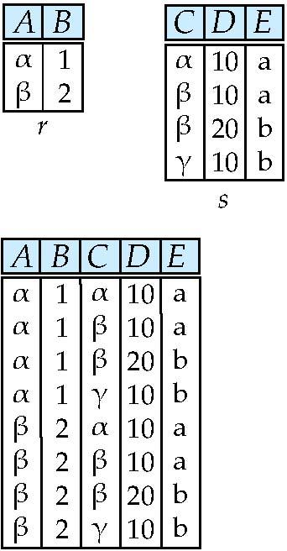
joining two relations -- Cartesian-product
Relations r, s:
r x s:
Notes:
24

Slide 25
Cartesian-product – naming issue
B
Relations r, s:
r.B
s.B
r x s:
Notes:
25

Slide 26
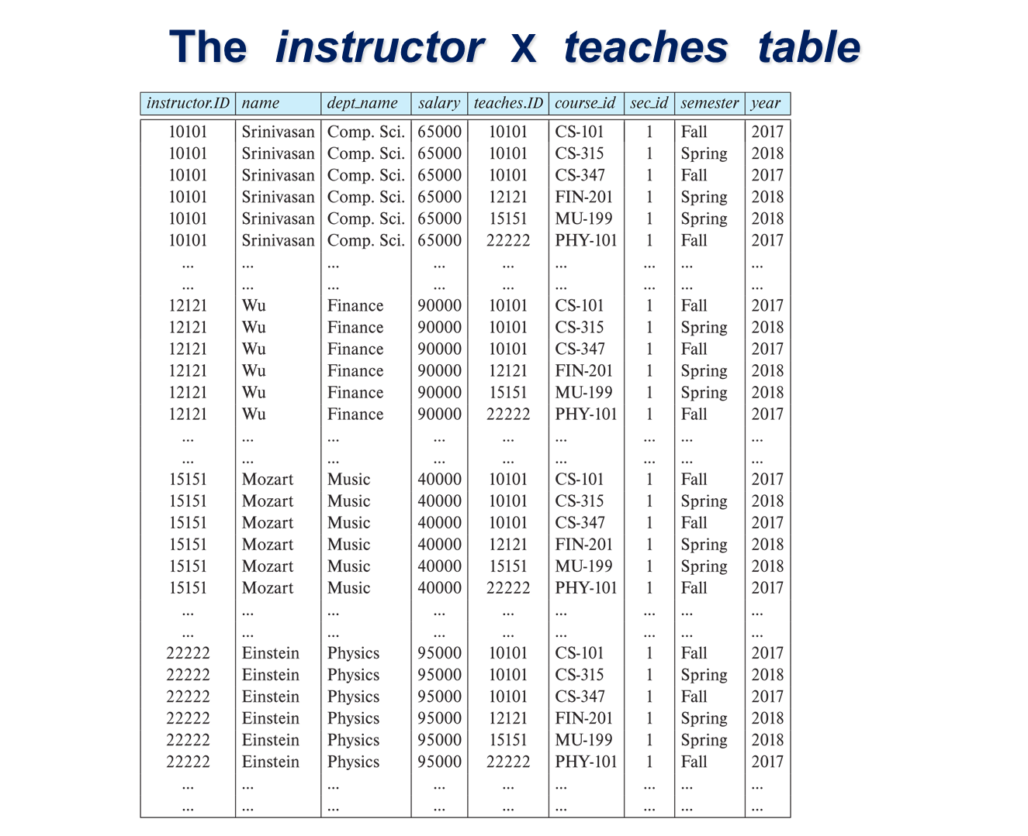

Slide 27
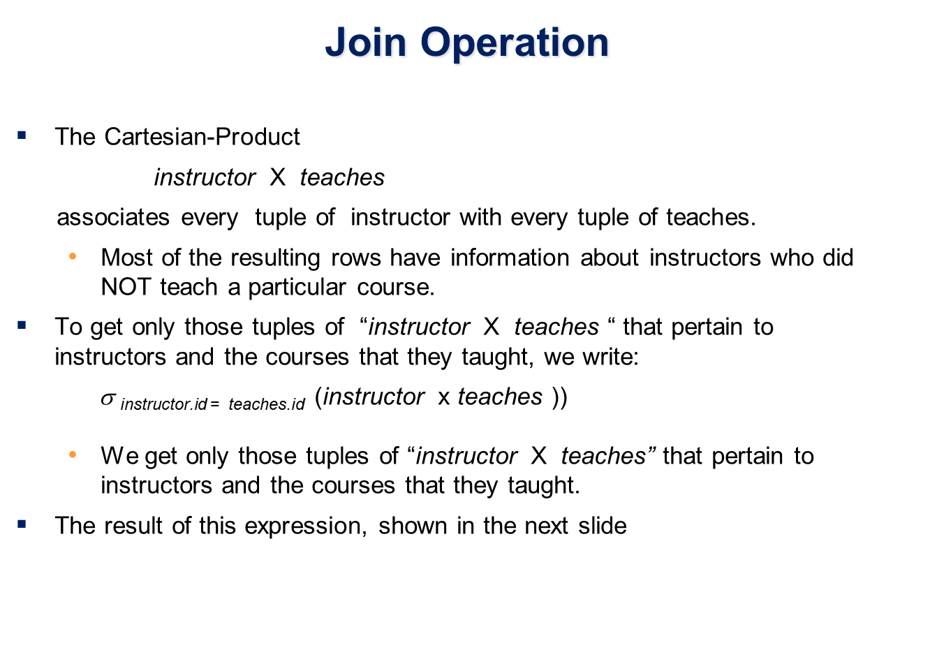

Slide 28
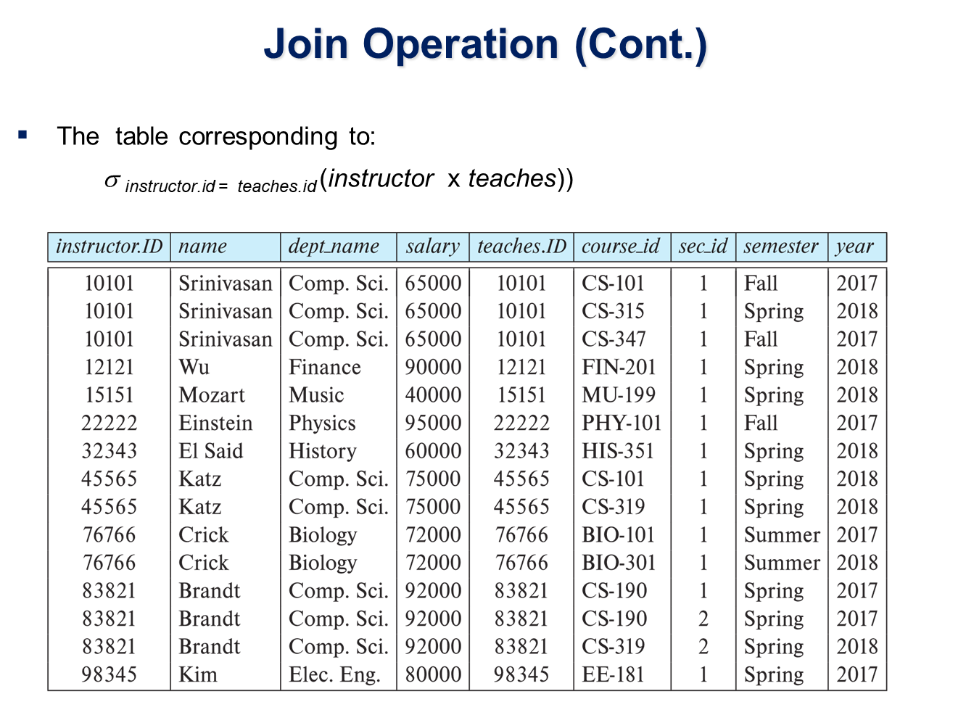

Slide 29
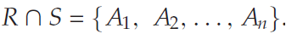
Joining two relations – Natural Join
Let r and s be relations on schemas R and S respectively. Then, the “natural join” of relations R and S is a relation on schema R ∪ S obtained as follows:
Where
Note that if r (R) and s(S) are relations without any attributes in common, that is,
Example:
R = (A, B, C, D)
S = (E, B, D)
Result schema = (A, B, C, D, E)
r s is defined as: ∏_{r.A, r.B, r.C, r.D, s.E} (σ_{r.B = s.B ∧ r.D = s.D} (r x s))
Notes:
29

Slide 30
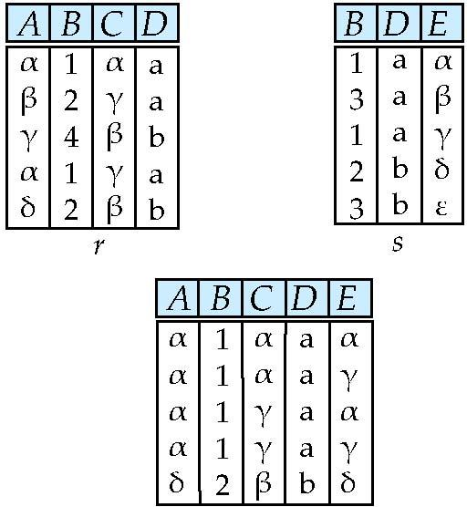
Natural Join Example
Relations r, s:
Natural Join
r s
∏ _{A, r.B, C, r.D, E} (σ _{r.B = s.B ˄ r.D = s.D} (r x s)))
Notes:
30

Slide 31
Natural Join and Theta Join
Find the names of all instructors in the Comp. Sci. department together with the course titles of all the courses that the instructors teach
∏ _{name, title} (σ _{dept_name=“Comp. Sci.”} (instructor teaches course))
Natural join is associative
(instructor teaches) course is equivalent to instructor (teaches course)
Natural join is commutative
Instructor teaches is equivalent to teaches instructor
The theta join operation r _{θ} s is defined as
r _{θ} s = σ_{θ} (r x s)

Slide 32
Outer Join
An extension of the join operation that avoids loss of information.
Computes the join and then adds tuples form one relation that does not match tuples in the other relation to the result of the join.
Uses null values:
null signifies that the value is unknown or does not exist
All comparisons involving null are (roughly speaking) false by definition.
We shall study precise meaning of comparisons with nulls later
Left outer join
Right outer join
Full outer join

Slide 33
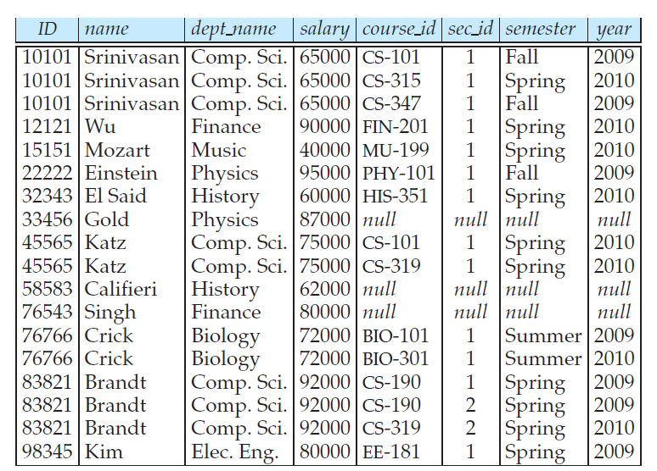
Left outer join : Example
instructor teaches

Slide 34
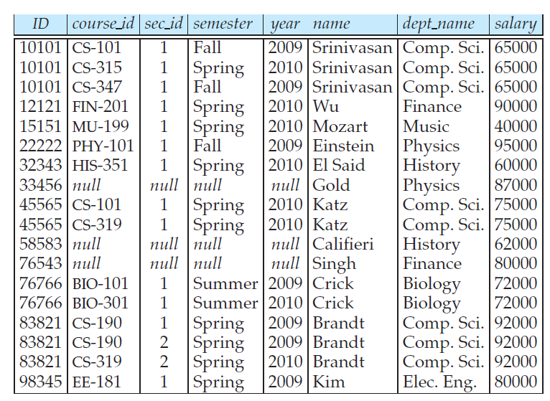
Right outer join : Example
teaches instructor

Slide 35
Outer Join – Example
Relation instructor1
ID
name
dept_name
10101
12121
15151
Srinivasan
Wu
Mozart
Comp. Sci.
Finance
Music
Relation teaches1
ID
course_id
10101
12121
76766
CS-101
FIN-201
BIO-101

Slide 36
Outer Join – Example
Join instructor teaches
ID
name
dept_name
course_id
10101
12121
Srinivasan
Wu
Comp. Sci.
Finance
CS-101
FIN-201
Left Outer Join
instructor teaches
ID
name
dept_name
course_id
10101
12121
15151
Srinivasan
Wu
Mozart
Comp. Sci.
Finance
Music
CS-101
FIN-201
null

Slide 37
Outer Join – Example
Right Outer Join
instructor teaches
ID
name
dept_name
course_id
10101
12121
76766
Srinivasan
Wu
null
Comp. Sci.
Finance
null
CS-101
FIN-201
BIO-101
Full Outer Join
instructor teaches
ID
name
dept_name
course_id
10101
12121
15151
76766
Srinivasan
Wu
Mozart
null
Comp. Sci.
Finance
Music
null
CS-101
FIN-201
null
BIO-101

Slide 38
Outer Join using Joins
Outer join can be expressed using basic operations
e.g. r s can be written as
(r s) U (r – ∏_{R}(r s) x {(null, …, null)}

Slide 39
Null Values
It is possible for tuples to have a null value, denoted by null, for some of their attributes
null signifies an unknown value or that a value does not exist.
The result of any arithmetic expression involving null is null.
Aggregate functions simply ignore null values (as in SQL)
For duplicate elimination and grouping, null is treated like any other value, and two nulls are assumed to be the same (as in SQL)

